Slide 1


Digital Front Desk System
Modernizing Patient Management for Private Hospitals in India
Software Engineering (CO311)
CSB23010 | CSB23012
Autumn
25th November
2025
CSB23016 | CSB23017

Slide 2


THE PROBLEM STATEMENT
"Traditional processes consist of disconnected steps... increasing the risk of critical errors."
Fragmented Workflows: Disconnect between reception, billing, and clinical staff.
Manual Data Entry: High risk of clerical errors in patient records.
Inefficiency: Long wait times lead to patient dissatisfaction.
Compliance Gaps: Difficulty adhering to NDHM standards with paper files.

Slide 3








THE SOLUTION SCOPE
Receptionist Module
Integration Hub
Core Functions
A specialized, web-based interface designed strictly for front-desk efficiency, not a full HIS replacement.
Acts as the bridge between HIS, LIS, Payment Gateways, and NDHM/ABDM national services.
Streamlines Appointments, Registration, Queues, Billing Initiation, and Communications.

Slide 4

REGISTRATION & QUEUE MANAGEMENT
Patient Registration
Queue Management
Standardizing entry with NDHM compliance.
Reducing chaos in waiting areas.
Captures Demographics & ID Proofs securely.
Auto-generates sequential tokens.
ABHA Integration: Auto-generates or links Health IDs.
Real-time Sync: Updates waiting room screens instantly.
Assigns unique Medical Record Number (MRN).
Automated SMS/WhatsApp notifications.

Slide 5
BILLING & INSURANCE VERIFICATION
Billing Initiation
Insurance Check
Capturing revenue before care begins.
Preventing claim rejections.
Creates "Provisional Bills" at the front desk.
Real-time Eligibility: API-based coverage checks.
Accepts multi-mode payments (Cash, UPI, Card).
Reconciles immediately with HIS finance modules.
Supports AB-PMJAY government schemes.
Automated pre-authorization workflows.

Slide 6



NON-FUNCTIONAL REQUIREMENTS
Security
Performance
Compliance
Role-Based Access Control (RBAC). TLS 1.2+ Encryption. Audit Trails for all actions.
Token issuance < 2 seconds. Supports 100+ concurrent sessions. 99.5% Uptime SLA.
NDHM/ABDM standards. NABH data retention policies. Data residency within India.

Slide 7

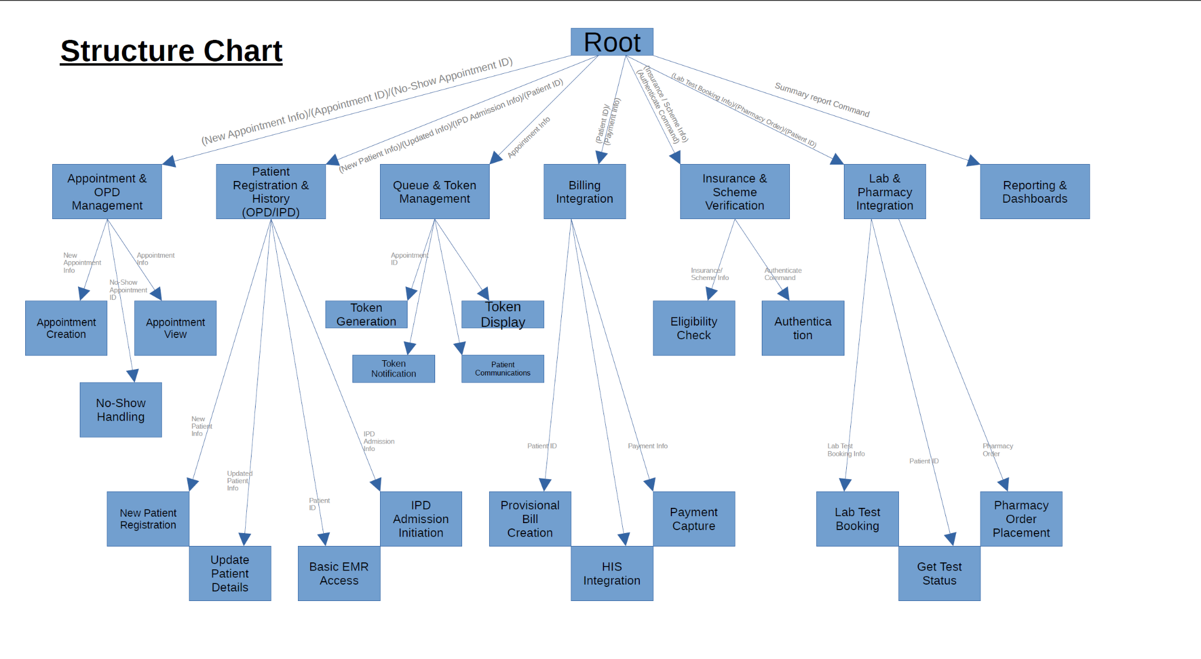
SYSTEM ARCHITECTURE
Level 0 Data Flow Diagram
The DFD acts as the central orchestration hub.
Inputs: Patient Data, Payments, Appt Requests.
Outputs: Tokens, Receipts, Notifications.
Connectors: Bridges Receptionist, HIS, and Patients.

Slide 8

DATA MODEL & ENTITIES
Core Entities
Transactional Entities
Patient: MRN, ABHA, Demographics.
Encounter: Clinical Visit Record.
Appointment: Doctor Link, Time Slot, Status.
Provisional Bill: Line Items, Totals.
Token: Queue Number, Issue Time.
Payment: Transaction ID, Method, Status.

Slide 9



INTEGRATION & TECH STACK
Environment
Standards
Security
Linux (Ubuntu LTS) on Cloud/On-Prem. Node.js / Java Backend. PostgreSQL Database.
HL7 v2.x: Legacy HIS. FHIR R4: NDHM Data Exchange. JSON/REST: Internal APIs.
OAuth2 Authentication. Swagger/OpenAPI Docs. Encrypted Data Storage.

Slide 10

PRIMARY WORKFLOW
Walk-in Registration Flow
1.
Scan: Receptionist scans ID or ABHA QR code.
2.
Create: System auto-generates MRN.
3.
Issue: Digital token is assigned to patient.
4.
Sync: Queue screens update instantly.
5.
Notify: Patient receives SMS confirmation.

Slide 11
VALIDATION & TESTING
ID | Acceptance Criteria / Test Case | Metric
AC-01 | New Patient Registration Sync to HIS | < 5 Seconds
AC-02 | Token Display Update Latency | < 2 Seconds
TC-001 | ABHA Integration (Valid/Invalid Flag) | Pass / Fail
TC-004 | Insurance API Failure Fallback | Graceful Msg

Slide 12
Project Outcome & Review
A robust, compliant, and efficient Digital Front Desk solution.
Compliances
Operational Efficiency
Design
Future- Ready Standards
Automated Workflow & Low Latency
Modular, Scalable, and API-Driven

Slide 13

THANK YOU
Questions?

